Slide 1

Quality Wine
Alec Kim
Sadhna Chaurushia
Adam Nguyen
Jose Dominguez

Slide 2

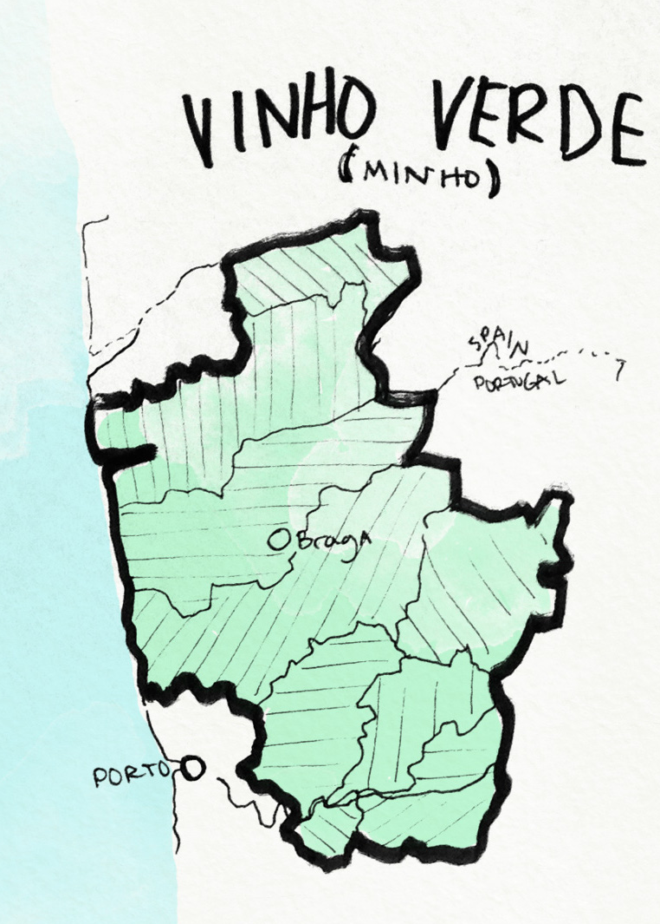
Our dataset
2 datasets related to red and white variants of the Portuguese "Vinho Verde" wine.
Due to privacy and logistic issues, only physicochemical (inputs) and sensory (the output) variables are available.
The classes are ordered and not balanced (e.g. there are many more normal wines than excellent or poor ones).
Outlier detection algorithms could be used to detect the few excellent or poor wines.
For more details, please visit https://archive.ics.uci.edu/ml/datasets/Wine+Quality

Slide 3




Project Requirements
Includes
Models
Data
Interactive & Views
Python
Flask
Matplotlib
Sklearn
Keras
4 Classification Models
7,000 records
HTML/CSS
1 Decision Tree
1 Web App

Slide 4
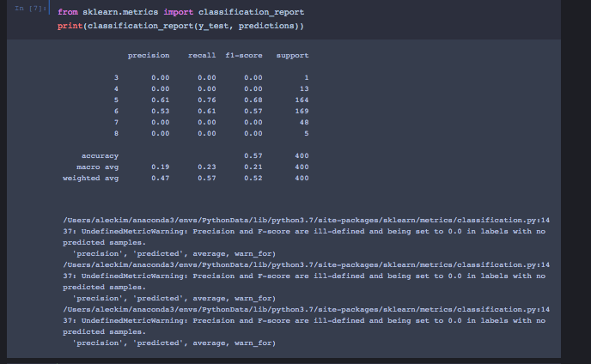
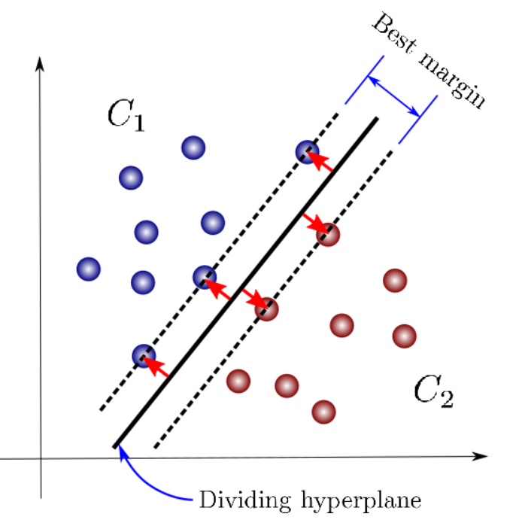
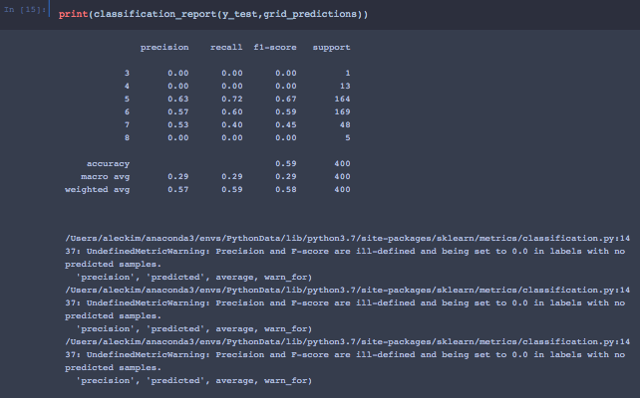
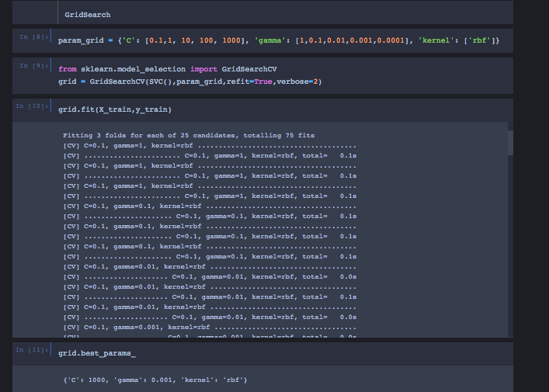
Model 1 SVM

Slide 5
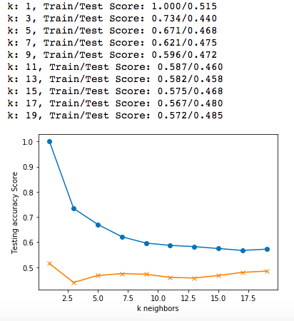
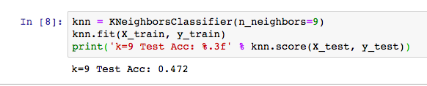
Model 3
KNN

Slide 6
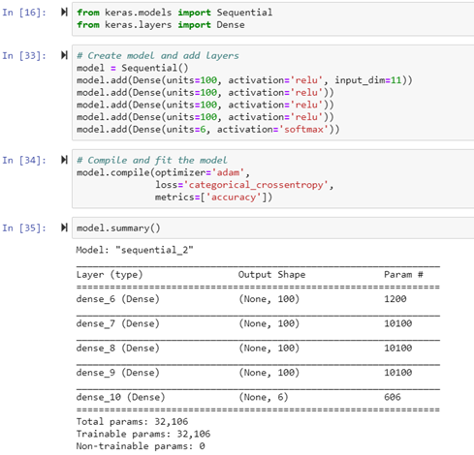
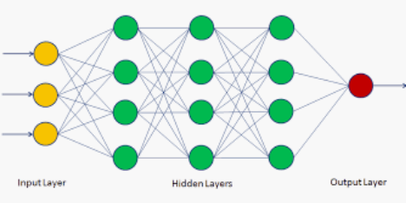
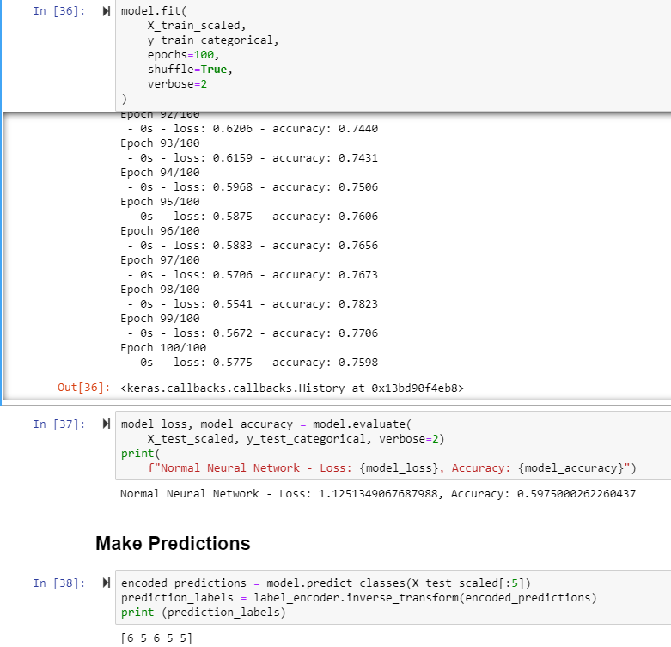
Model 3 Neural Network

Slide 7
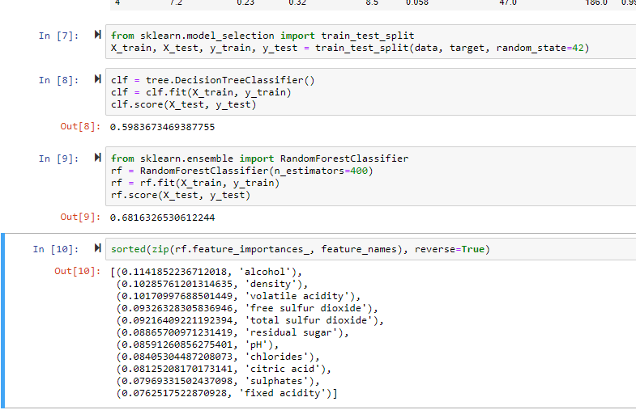
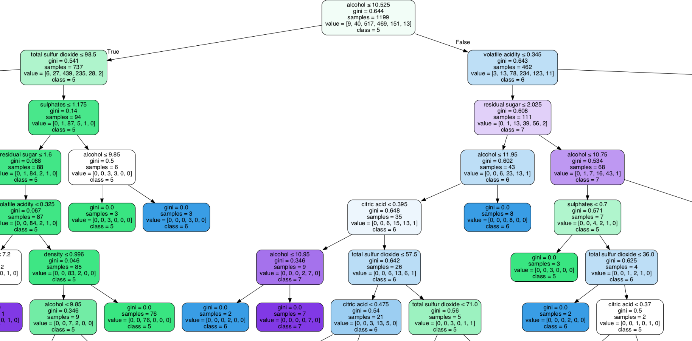
Model 4 Decision Tree & Random Forest

Slide 8
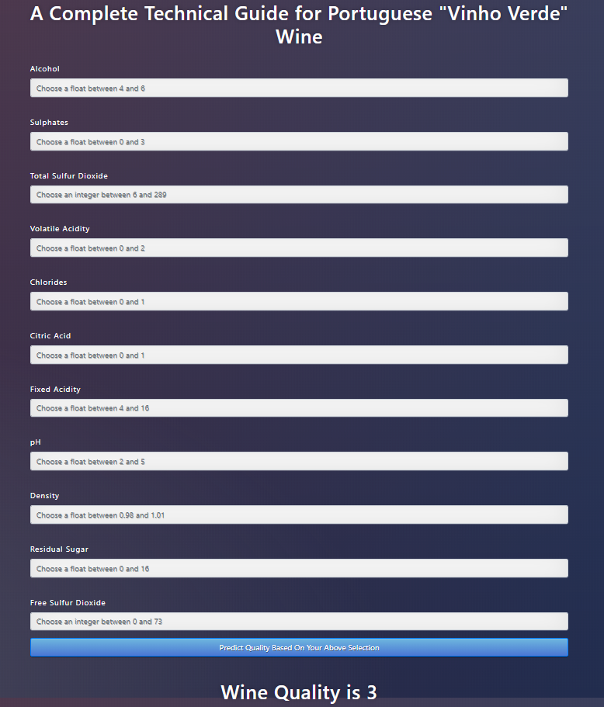
Web Application

Slide 9
THANK YOU

